Slide 1
Welcome & Introductions
Duane Evans, Board Chair
WDC Members Introductions
  Name
  Business/Organization
  Representing County or Regional Seat
  Committee Assignment
  Why did you choose PacMtn to invest and serve?

Slide 2
2018 Board Orientation
Satsop Business Park
July 26, 2018

Slide 3
Purpose of Orientation
Provide information about PacMtn & the workforce system so Members can function as effective WDC Board members
Answer lingering questions
Deepen relationship with other Board Members and staff

Slide 4
Specific Learning
PacMtn organizational structure
Recognize the purpose of Board and each committee and task force
Overview PacMtn’s budget process
Exhibit knowledge of current workforce issues facing the PacMtn region
Familiarity with PacMtn programs & services

Slide 5
Longstanding Workforce Commitment
Manpower (aimed at larger cities)
CETA (Comprehensive Employment & Training Act)
JTPA (Job Training Partnership Act, 1982)
WIA (Workforce Investment Act, 1998)
WIOA (Workforce Innovation & Opportunity Act, 2014)

Slide 6
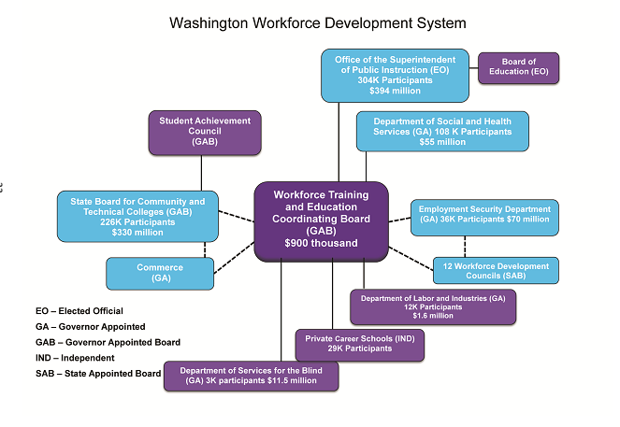
PacMtn

Slide 7
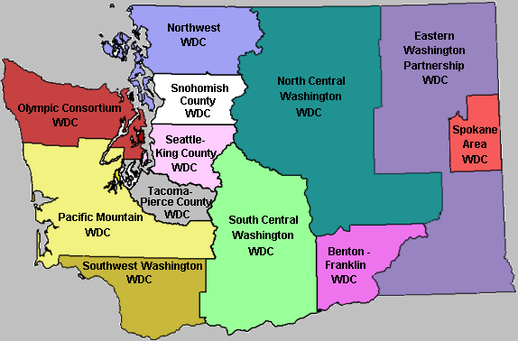
Workforce Development Councils (WDC)

Slide 8
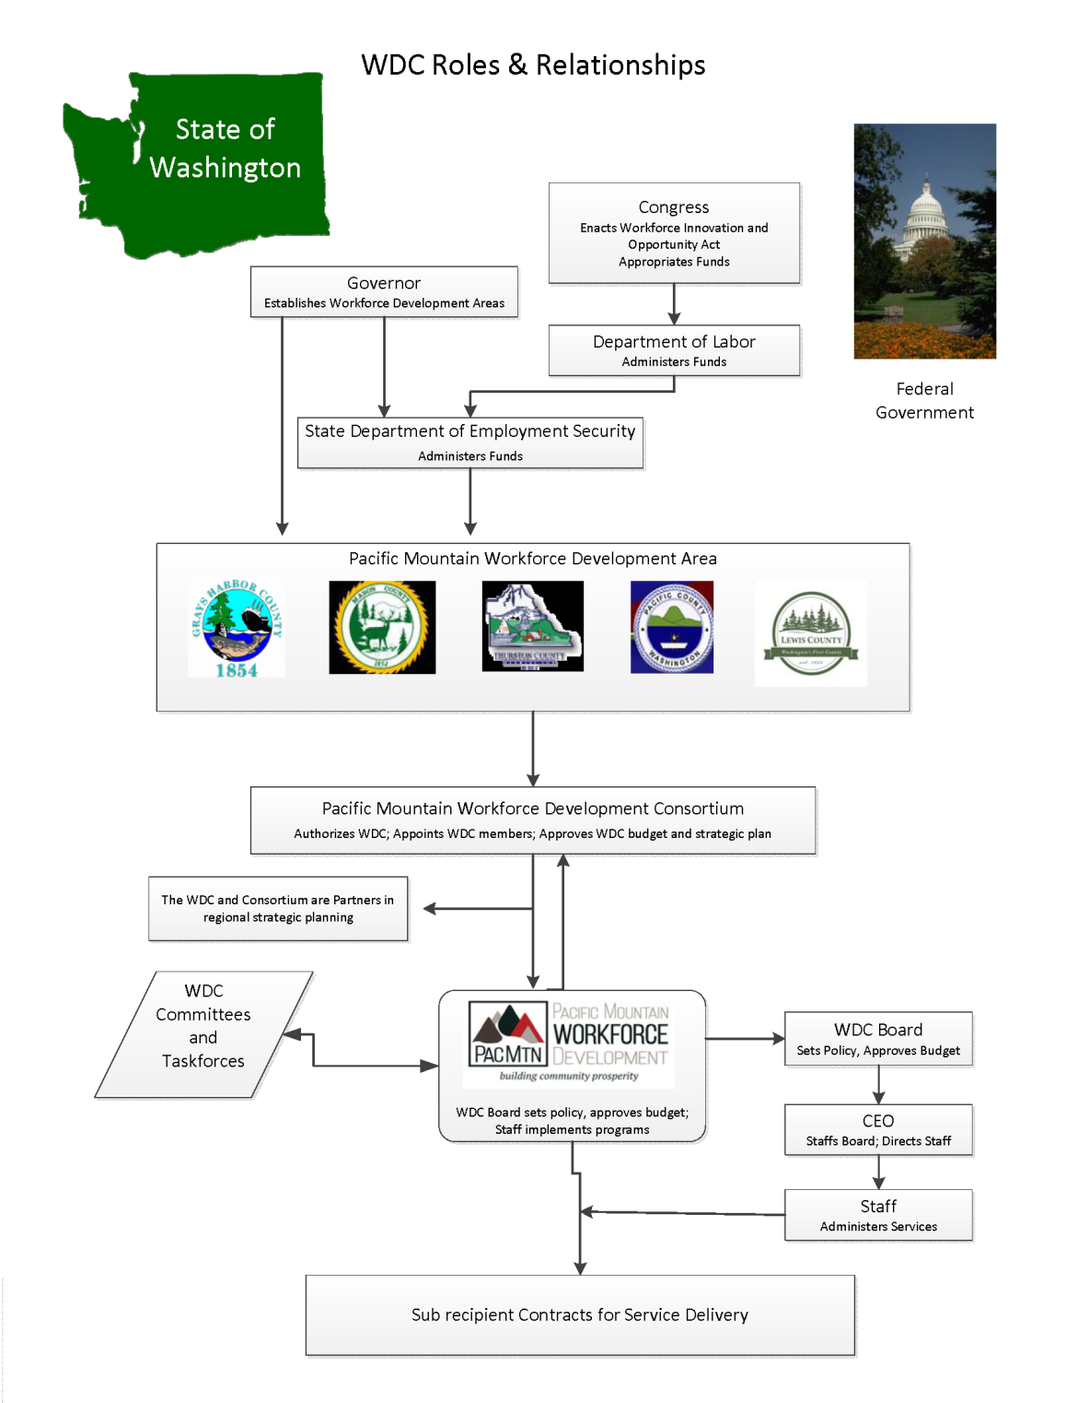

Slide 9
WIOA 13 Section 107
Local plan…develop and submit a local plan to the Governor
Workforce research and regional labor market analysis…carry out analyses of the economic conditions in the region, assist the Governor in developing the statewide workforce and labor market information system, conduct other research, data collection, and analysis
Convening, brokering, leveraging…convene local workforce development system stakeholders to assist in the development of the local plan to carry out the functions
Employer engagement…lead efforts to engage with a diverse range of employers to promote business representation, to develop effective linkages with employers, to ensure that workforce investment activities meet the needs of employers and support economic growth and develop and implement proven or promising strategies for meeting the employment and skill needs of workers and employers
Career pathways development…lead efforts to develop and implement career pathways
Proven and promising practices…lead efforts to identify and promote proven and promising strategies and initiatives…identify and disseminate information on proven and promising practices

Slide 10
Functions continued
Technology… develop strategies for using technology to maximize the accessibility and effectiveness of the local workforce development system for employers, workers and jobseekers
Program oversight…conduct oversight for local youth workforce investment activities, local employment and training activities, and the one-stop delivery system in the local area; and ensure the appropriate use and management of the funds , ensure the appropriate use, management, and investment of funds to maximize performance outcomes
Negotiation of local performance accountability measures… negotiate and reach agreement on local performance accountability measures
Selection of operators and providers...Selection of One-stop operators; selection of youth providers, identification of eligible providers of training services; identification of eligible providers of career services; and consumer choice requirements…
Coordination with education providers…coordinate activities with education and training providers in the local area
Budget and administration… develop a budget for the activities of the local board
Accessibility for individuals with disabilities…annually assess physical and programmatic accessibility

Slide 11
Our Mission & Vision
Mission: to lead dynamic regional workforce development that enhances economic success.
Vision: PacMtn is recognized leader providing workforce solutions in Grays Harbor, Lewis, Mason, Pacific, and Thurston Counties.

Slide 12
Values
Customer emphasis that puts the public at the center of every decision & action.
Ensure all counties are achieving economic success for the benefit of the region.
Innovation and creativity as the backbone of progress & support of daily activities.
Diversity of thoughts, ideas, and solutions achieved by honoring diverse perspectives.
Integrity, honesty, transparency, personal excellence, constructive self-assessment, continuous self-improvement, and mutual respect as an organization and as individuals.

Slide 13
Elevator Speech
PacMtn is a community based organization that provides workforce solutions for job seekers, career builders and the businesses who need workforce talent.

Slide 14




PacMtn Governance Structure
Elected Official Consortium
Targeted Populations Committee
One-Stop Operations Committee
PACMTN Board
Direct and advise on activities that expand access to workforce services for youth and targeted/specialized populations, while demonstrating the value of these populations to business, labor and industry.
Provides policy guidance and recommendation for the One-Stop System and activities related to workforce service delivery and programs.
BaSE
Adult Basic Education and Literacy Taskforce
Provides guidance on initiatives specific to industry and employer services related to One-Stop and targeted populations and focus on continuous improvement to accomplish fundamental goals for the region’s workforce system
Provides recommendations and guidance on the roles of Adult Basic Education in the Workforce System.
Executive Finance Committee
Directs and manages the activities, as well as, development of financial policies and budgets of PacMtn WDC.

Slide 17






Industry Sectors
In late 2012 PacMtn published the Industry Cluster Study identifying the 6 top regional sectors. In 2015 the sectors were updated and a complete review will occur in 2019.
https://pacmtn.org/regional-sectors/
IT & Telecom
Chemicals & Plastics Manufacturing
Tourism & Recreation
Food Production
Life Science
Wood Products & Paper Manufacturing

Slide 18
Take a 10 min break…
When you return please share one surprising thing you learned in the first half of the Orientation.

Slide 19
WDC Board Overview
Board Composition – 26 member seats, All approved by the Consortium
  15 local business leaders--3 per county
  Labor, Apprenticeship, State Employment Services
  Disability-based employment/Training
  Higher education and K-12
  Adult Education & Literacy
  Community Based Organization
Job #1…Build a dynamic workforce and pipeline of talent for the economy
  Job creation & retention
  Innovation and system evolution
  Cultivating new & existing partnerships
  Performance & accountability

Slide 20
Formal Board Member Roles
Stewardship of funds and reputation
Community and interest advocacy for PacMtn programs and services
Oversight of the CEO for management of the business, programs and services
Active participation in 75% of Board and Committee meetings

Slide 21
Board Member Roles
Duty of Attention
  Full participation
  Practical inquiry
  Duty of Allegiance
    Address conflict of interest & confidentiality
    Printed policies for conflict
    Attention to funding sources & potential opportunities

Slide 22
Board Member Roles
Duty of Agreement
  Federal, State & Local laws
  Mission, vision, values, services, policies & programs
  Other Duties
  Records & documents
  Fiscal controls & documents
  Accountable solicitation & engagement
  Safeguarding

Slide 23
Board Member Expectations
Strategic support & expertise to shape the workforce development system
Engender community support
Create a positive governance environment
Be a thought leader and visionary
Understand skills needed for 21st century jobs and the requirements for well trained workforce
Business representatives ready to represent and speak to regional cluster and industry trends and needs

Slide 24
Board Member Expectations
Be prepared for Board meetings
Build relationships that contribute to effective decision making with other Board members
Act and vote on behalf of the long term interests of regional employers, labor force and the community – not on the interest of a single constituency
Understand and observe the roles of the WDC, staff, One Stop Operator, service providers and the Consortium
Focus on policy elements, not operational and staff level details

Slide 25
Board Member Expectations
Stay up-to-date on existing and current workforce concerns and PacMtn activities
Attend and actively participate in 75% of scheduled Board and Committee meetings
Act as an ambassador of the workforce system in community and business groups
Utilize business and partner resources of the local WorkSource

Slide 26
Fiscal Accountabilities
501c3 community non-profit with full transparency
Oversight of PacMtn budget
Monitor organization’s financial health
Ensure review of audit of financial results
Ensure management files IRS 990s
Ensure key risks are identified and managed
Ensure applicable legal polices are in place and enforced

Slide 27
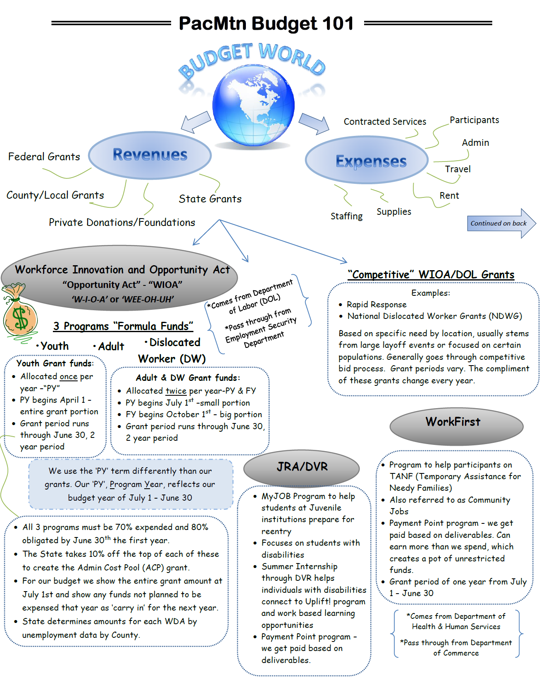
Fiscal Information

Slide 28
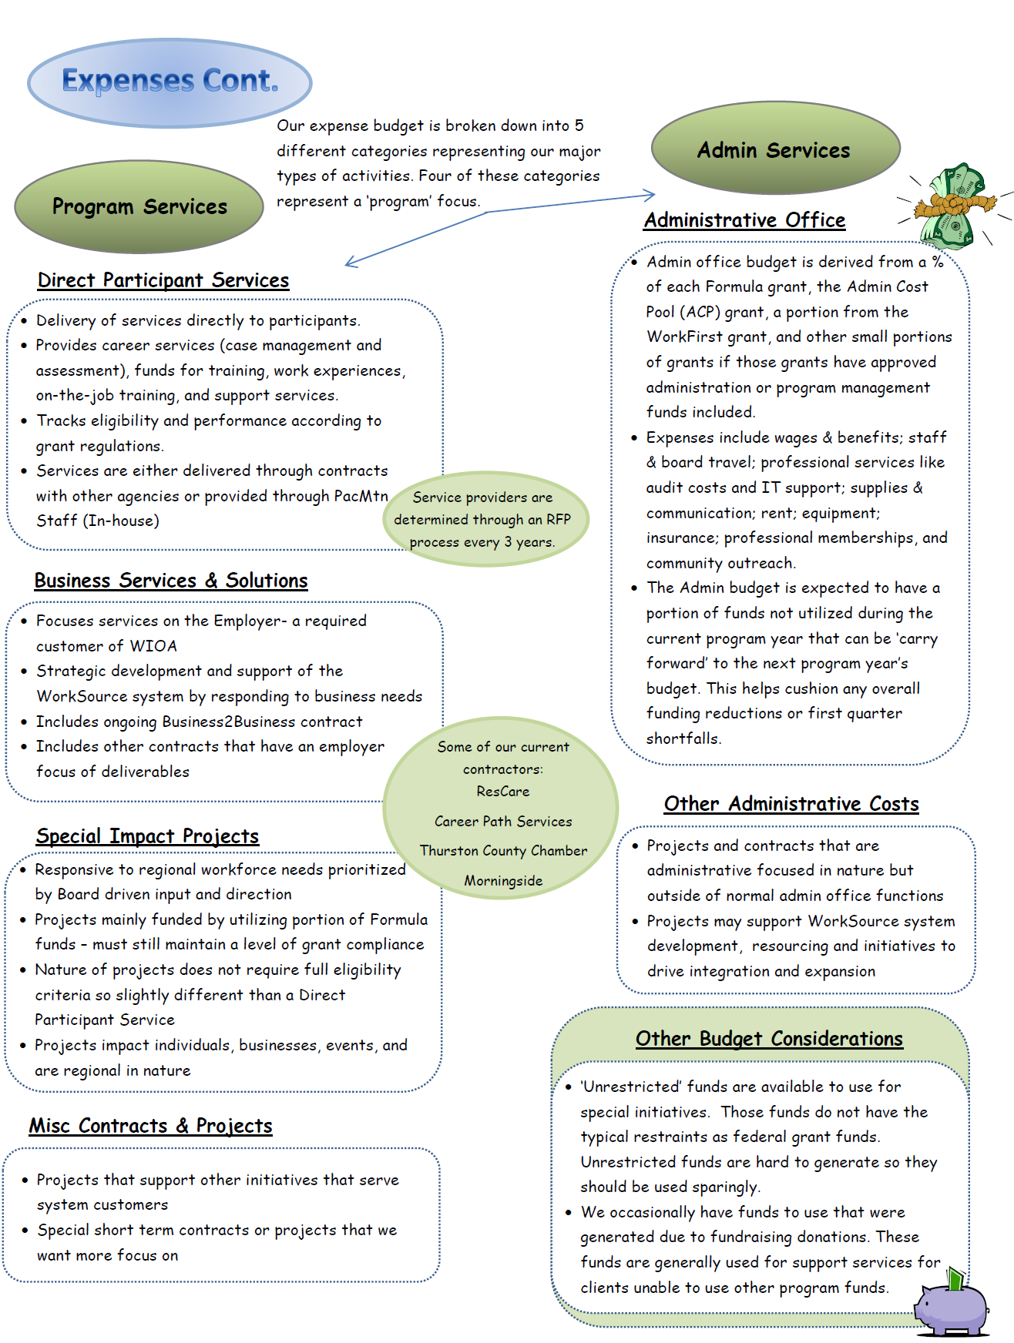
Fiscal Information

Slide 30
Want Additional Information?
www.PacMtn.org

Slide 31
Questions for Further Consideration
What burning question yet remains?
What additional activity would you consider, if you had more information?
What is the single most important thing for a new Board Member to understand?

Slide 32
Questions for Further Consideration
How will you apply today’s learning?
What PacMtn staff person, project or activity would you like to spend an additional hour focused upon?

