Slide 1
Camo2Commerce
Leveraging the Public Workforce System

Slide 2
Camo2Commerce
Public Workforce System dislocated worker initiative designed to connect those in transition into high demand civilian employment; including both servicemembers and spouses
Counseling
Training
Placement
Partnership: Military, Business, Community Colleges, Chambers of Commerce, Economic Development

Slide 3
Accomplishments
Data
Legacy
Direct Enrollments
1850
Placements
1369
Apprenticeship
397
Placement Rate 85%
Establishment of American Job Center (WorkSource JBLM)
1st to Actively Integrate into Military Transition Services
Launch of Corporate Fellowship Program, Now Managed Nationally by Hiring Our Heroes.
Have Since Launched Work-Ex and Spouse Ambassador Program
Development of Career Skill Programs and Veterans Industry Education (VIE 25)

Slide 4
Work-Based Learning
WBL Overview
Program Results
Utilizes a model college students have used for generations.
Bridges the gap between military and civilian.
Provides a foot in the door.
Corporate Fellowship Program
Work-Ex (Internship Program)
78 total enrolled in Work-Ex
12 currently in an internship
21 in the current pipeline/pending start
34 placed upon completion (9 with host)
Spouse Ambassador Program
9 started
4 remain
4 accepted full time positions
Work-Ex Employers
Amazon
Olympic Ambulance
PacMtn WDC
Coast Flight
City of Lakewood
Fairway Mortgage
McKinstry
TerraPower
Wilcox Family Farms
Keller Williams
Alaska Airlines
Starbucks
Kaiser Permanente
41 more employers…

Slide 5
Work-Ex: Success
Spouse
Servicemember
“After spending weeks looking for work post-PCS move, it wasn’t long until I met Michele and she connected me to the right internship opportunity at Amazon via WorkEx. Through effective resume and interviewing workshops she provided, I was well prepared for the application process and quickly move forward with the hiring manager from applicant to intern. Throughout the internship, Michele and team were extremely supportive and quick to respond to any needs or concerns I may have had. I’ve now accepted a full time position through my internship and count be happier with the results! As a military spouse on the move I’m lucky to have found the WorkEx program that has supported this forward momentum in my career. I’m happy to say that upon completion of my WorkEx I was offered a full-time Business Analyst position at my host company. Thank you!” –Raul, Amazon
Transitioning Service Member Steven Howe began planning for his retirement a year out. Steve and I connected at one of the Targeted Resume Training classes he attended (in all, he attended the trainings 6 times each). Throughout numerous discussions with Steve we determined that the Work Ex program would be a great fit for him. He was able to connect with members of the McKinstry Co., LLC team. I set up a shadow opportunity for him and they all realized it was a perfect match. At this time, I was still finalizing the relationship with McKinstry to bring them onboard as a Work Ex employer partner. I worked with their leadership team to complete the paperwork and get Steve on board. He is now in week 4 of his internship opportunity and all roads indicate that he will receive a full time offer of employment at the end of his Work Ex.

Slide 6
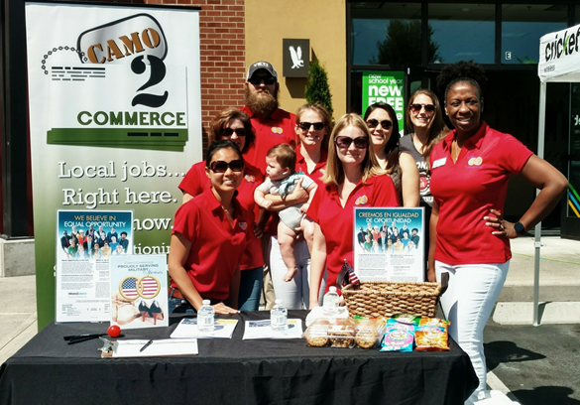
Year of the Spouse
TEDx – Transitions: Bridging the Gap (Friday, November 16th @ JBLM)
Spouse Cohorts:
Entrepreneur
Non-Profit Fundraising
Spouse Ambassador Program

Slide 7
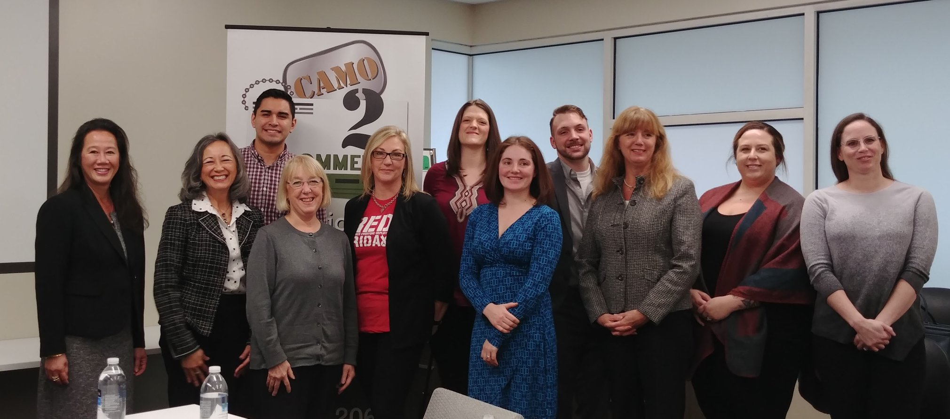
What’s Next?
JBLM WorkSource certified for another 2 years
PacMtn will continue with 2 Counselors focusing on Spouses/Transitioning Military
Work-Based Learning
Manufacturing
General Career Support
Funding Beyond 2018
No Cost Extension?
Boeing Grant
Rapid Response

Slide 8
Hire America – Rural Veterans
Hire America
Episode 117
"Considering living and working in rural America after your transition"

Slide 9
Contact Information
Thank you for your dedication to military families!
Sean Murphy
Associate Director – Strategic Initiatives
Pacific Mountain Workforce Development
(206) 914-1842
Sean@pacmtn.org

