Slide 1
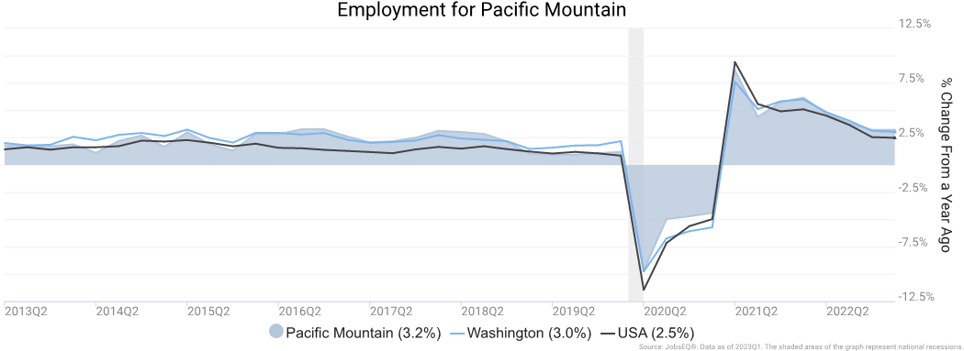
Employment Trends
As of 2023Q1, total employment for the Pacific Mountain was 210,344 (based on a four-quarter moving average). Over the year ending 2023Q1, employment increased 3.2% in the region.

Slide 2
Occupation demographics by age are modeled based upon employment by occupation at place of residence and zip-code level data from the American Community Survey, 2017-2021. The bureau of labor statistics as a definition for “Prime Age” which could then be coupled with Labor force participation rates to define the Primary working age would be for a region or county. The visualization below reflects occupational diversity within the PacMtn region.

Slide 3
Unemployment Rate
The unemployment rate for the Pacific Mountain was 3.7% as of July 2023. The regional unemployment rate was lower than the national rate of 3.8%. One year earlier, in July 2022, the unemployment rate in the Pacific Mountain was 4.8%.

Slide 4
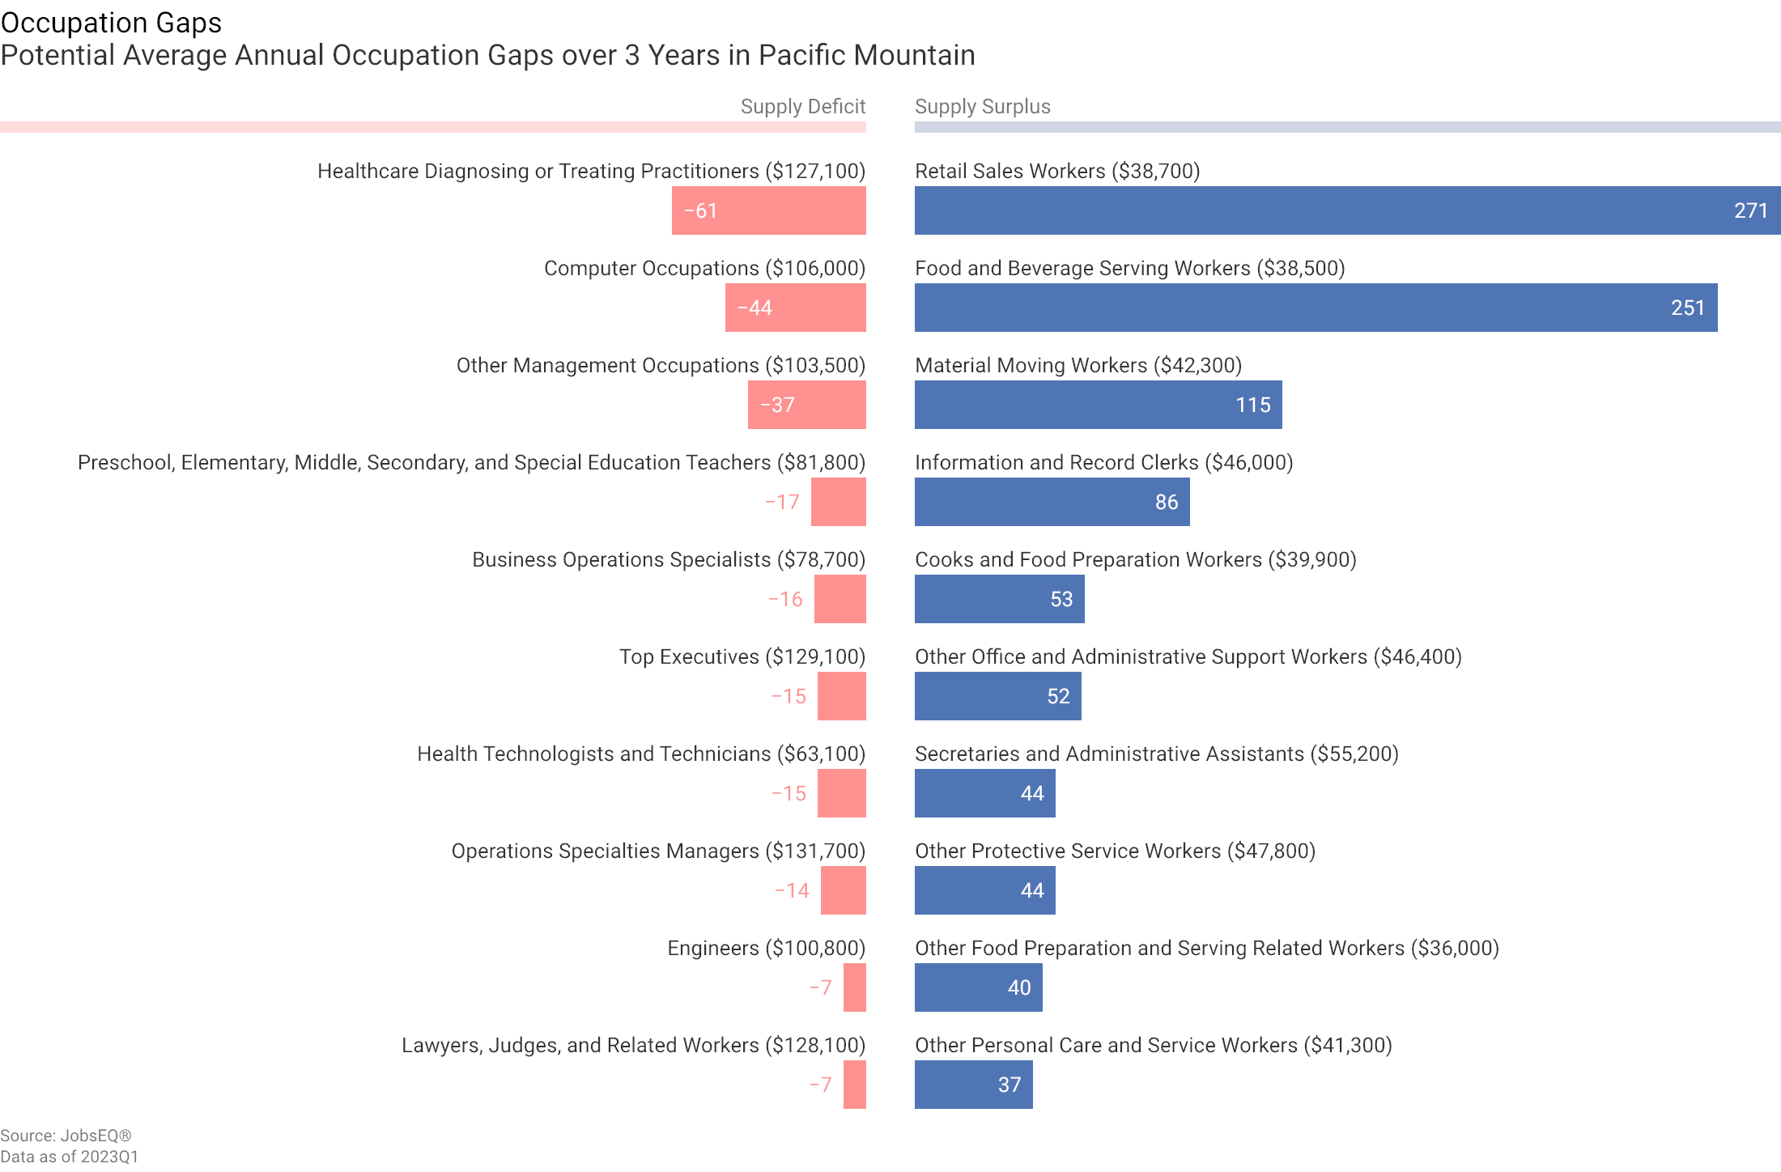
The potential supply shortfall is an underlying force that the market needs to resolve one way or another. While this an important analysis for determining local occupation needs, the occupation gap should be considered along with other regional data including growth and separation forecasts, unemployment rates, wage trends, and award and skill gap analyses.

Slide 5
Wage Trends
The average worker in the Pacific Mountain earned annual wages of $59,688 as of 2023Q1. Average annual wages per worker increased 5.5% in the region over the preceding four quarters. For comparison purposes, annual average wages were $68,501 in the nation as of 2023Q1.

Slide 6
Expected growth rates for occupations vary by the education and training required. Employers recruiting for these occupations can potentially resolve gaps in job requirements by creating increased demand and wages enticing more local residents to get training for these occupations.

Slide 7
Education Levels
Occupations typically requiring a postgraduate degree are expected to grow 1.7% per year, those requiring a bachelor’s degree are forecast to grow 1.5% per year, and occupations typically needing a 2-year degree or certificate are expected to grow 1.5% per year.

Slide 8
Awards data are based upon degrees conferred for the academic year 2020-2021 and are provided by the National Center for Education Statistics.

Slide 9
ALICE (Asset Limited Income Constrained Employed)

Slide 10
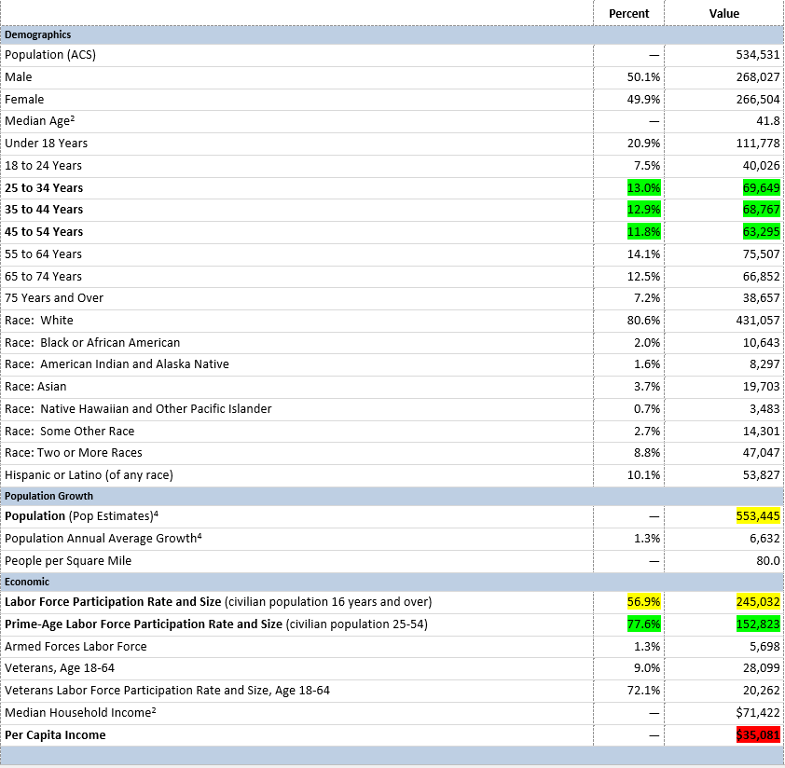
Demographics

Slide 11
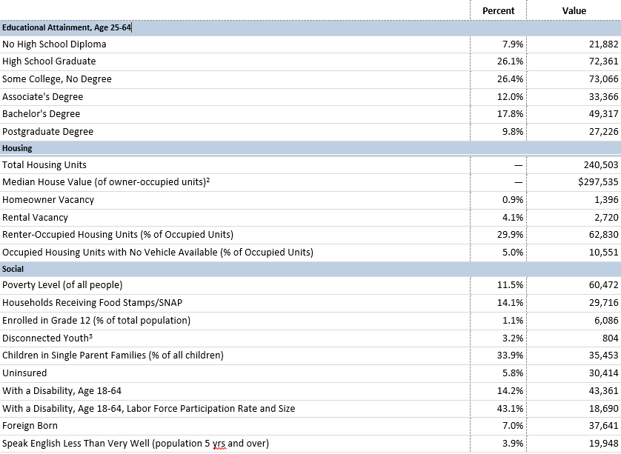
Demographics Continued

Slide 12
PacMtn Employment, Labor and Wage Insights
September 2023
JRO+CO
PacMtn Data Services
Preliminary Data
Notes:
This data set supports response to Federal Reserve Board questions in early Sep 2023
All data from JobsEQ unless otherwise noted
Some response pending, notably info around hours worked and industry dive-down

Slide 13
Notes:
Data not available at County level: This shows WA State, with notable drop-off in productivity for early 2022
WA is actually more productive than most other states, even with decline
Theories: people burned out after working harder than ever during pandemic transitions; depression form lack of gains given inflation and soaring home prices
Actually saw “work from home” productivity gains when people worked from home in 2020
*Source: FRED St Louis

Slide 14
Notes:
Leading up to the pandemic, PacMtn was growing emp at a slower rate than statewide av
But then also lost emp at a slower rate when the pandemic hit
It has grown emp slightly faster that WA most recently
Notably, PacMtn shed jobs at a much higher clip, and for longer, following the financial collapse of 2009
The difference in crisis outcomes is likely due to nature and concentration of state emp in our region

Slide 15
Notes:
The # of PacMtn establishments declined from 16,250 pre-pandemic to 14,584 as of the end of 2022
Interestingly, and not related to this analysis, there was a spike in establishments (here and elsewhere) mid-pandemic
It is unclear whether the above factoid is related to dislocated workers starting microbusinesses, existing businesses splitting off divisions, or people taking advantage of COVID funding (some of all probably)

Slide 16
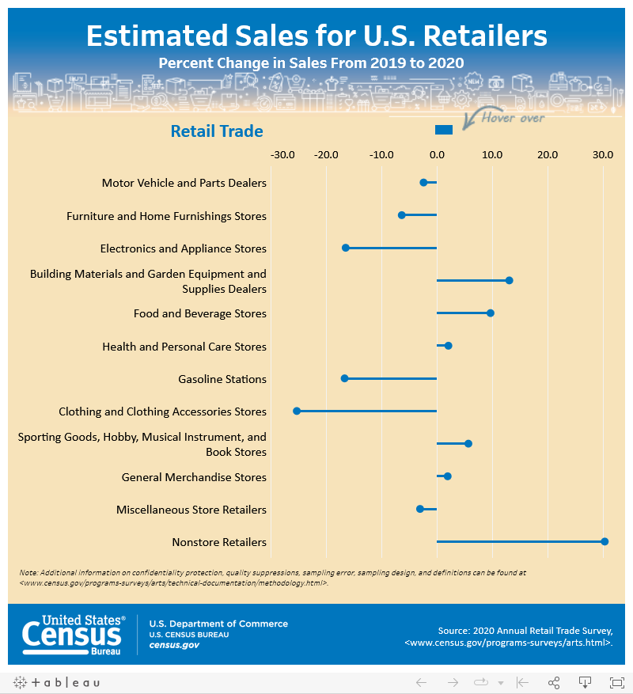

Slide 17
Notes:
The number of establishments gap has been widening for some time in PacMtn region
But there is a clear separation today (over 75% located in Thurston), likely given Thurston location on I-5, available housing, nearness to Sea-Tac metro region
*Data was produced for a separate analysis and does note include Lewis County. Can be amended as time allows, but general outcome will not change much statistically.

Slide 18
Notes:
Homing in a little bit, we see PacMtn emp volume reached an all time high in Q1 2023
Remember two slides back, where # of establishments dropped?
Here, we see emp has grown by about 10%
That means more employees are working in net fewer establishments, an increasingly large % of them in Thurston County

Slide 19
Notes:
And unemployment is at an historical (modern times) low in the region
We’ve even closed the gap with the statewide average
Which means workers have options
(We’ll set aside the discussion as to WHY unemployment rates are so low for another day... boomers retiring early, people giving up on work search, etc.)

Slide 20
Notes:
All of which means, PacMtn has seen a general wage increase since 2022
Surpassing the state increase for about a year and holding
That means either people are moving to new jobs or employers are paying more (or more people are coming here from other areas and commanding higher wages for higher talent?)

Slide 21
Notes:
Another way to look at employment is through shift share
Shift share shows the driving components of employment change
In this case, we can see – on average – industry conditions have actually been a drain on employment (supply chains, AI growth, et al)
We also see a general national recovery from the pandemic has led to employment growth
But most striking, local competitiveness has accounted for nearly half of jobs added over past 5 years

Slide 22
Notes:
And, finally, looking at shift share by major industry category
Considering we added a net total of approx. 1,400 jobs over 5 years since, 2018, we see a LOT of things. A few to highlight:
Government is still our core/base employer and responded well to a “work from home” type disaster
The growth in professional services (and local competitiveness) is likely due to early gov retirement and influx of urban residents (need to track)
Wholesale trade took OFF (track relative to continued pandemic recovery)
Construction is sailing
Manufacturing and ag are in a challenging stage locally
Real estate (particularly commercial) looks rough, but is probably where consolidation is happening (fewer realtors, but no drop in av wages)

Slide 23
Notes:
And currently (as of June), here’s where we see employer demand vis a vis job postings
This is a June snapshot
Money jobs with volume include:
Nurses, managers, state investment analysts, health techs, enviro scientists and nursing assistants (assuming pathway track)
Begs question: who/what occupations are going to survive automation...and this is an early hint

