Slide 1
Operations Plan Design
WorkSource is an equal opportunity employer/program. Auxiliary aids and services are available upon request to individuals with disabilities. Washington Relay Service: 711

Slide 2
Partner Coordination Team
Christina Chesnut, Thurston Chamber (Business Solutions)
Kayla Flint, EQUUS (WIOA Title I, EcSA, other)
Phyllis Martin, ESD Title III
Sean Wiley, ESD Title III
Chris Skinner / Tennille Johnson, ESD Title III
Jason Hoseney, PacMtn OSO

Slide 3
One Workforce - Guiding Documents

Slide 4
WIOA Under Attack

Slide 5
WIOA Under Attack
The Workforce Innovation and Opportunity Act job training programs should be eliminated, which would reduce discretionary budget authority by $38.915 billion during the FY 2022–FY 2032 period.
Source: Appropriations Subcommittee on Labor, Health and Human Services, Education, and Related Agencies
“After 50+ years of research, there is still no consensus on whether federally funded job training works.”
- Jeffrey Smith National Bureau of Economic Research

Slide 6
Threats and Challenges

Slide 7
Called to Redesign, Innovate, and Improve
“When enacted in 2014, the vision of WIOA was to redesign the workforce system to increase program collaboration at the federal, state, and local level to ultimately integrate all available programs and services to job seekers and businesses.”
Source: Advancing a One Workforce Vision and Strategy (TEN 13-20)
“Continuous Improvement: Old Way of Doing Business is Not an Option”
Source: Talent and Prosperity for All Strategic Plan, Pg. 26

Slide 8
The Legislation Can Work
Goal: Align our service delivery model to the Legislative intent

Slide 9
Wagner-Peyser Act of 1933
“Any job is a good job and that the best way to succeed in the labor market is to join it, developing work habits and skills on the job. Work first sends a strong message that employment is both the goal and the expectation.”
The Wagner-Peyser Act of 1933 (Title III) established a nationwide system of public employment offices, now known as the Employment Service. The Employment Service seeks to improve the functioning of the nation's labor markets by bringing together individuals seeking employment with employers seeking workers.

Slide 10
Wagner Peyser Act – Employment Security Labor Exchange Services
“The ES program provides vital self-service and informational services which would result in the ES program having a high percentage of reportable individuals. Even though these individuals are not included in the performance accountability calculations, ETA strongly supports these services.”
Source: TEGL 19-16, Page 21

Slide 11
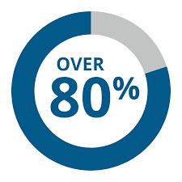
Wagner Peyser – Title III Self-Service and Informational Services
2020-2021 Total Seekers 12,143
2021-2022 Total Seekers 13,773

Slide 12
Customer Flow – Title III (Wagner Peyser Act)
Customer Contact
Labor Exchange Services
Job Match
RESEA Readily Available WorkSourceWA
Resource Room Information Job Fairs
Connection Sites
WorkSourceWA

Slide 13
Workforce Innovation and Opportunity Act - WIOA
These programs provide career and training services to hundreds of job seekers each year in the PacMtn Region.
Adult
Dislocated Worker
Youth

Slide 14
WIOA Traditional Approach vs Best Practices
Career and Training Services

Slide 15
WIOA Traditional Approach vs Best Practices
“less than 30 percent of the funding in WIOA for adult, dislocated worker, and youth activities went towards training services. Among those who do complete a WIOA-funded training program, only about one-third are employed in an occupation related to their program.
Source: Providing Public Workforce Services to Job Seekers: 30-Month Impact Findings

Slide 16
PacMtn WorkSource Region 2020-2021, 2021-2022
3,122 Adult, DW, and Youth Participants
529 Engaged in Training
(19%)

Slide 17
Strategic Co-Enrollment with WIOA Title I-B
Title II (Community Colleges)
AEFLA / Perkins
Title III (Wagner Peyser)
Title IV (Vocational Rehabilitation)
Title V (SCSEP – (Goodwill)
Community Based Organizations

Slide 18
Strategic Co-Enrollment with WIOA Title I-B
Two Approaches:
Recruit into Regional Sponsored Trainings
Integrate Our Services into Existing Services (add value)
Co-enrolled Integrated Service Delivery (ISD) is the delivery of WorkSource services in a manner that aligns/braids the resources of participating partners to seamlessly address the training and employment needs of job seeker and business customers. Co-enrolled ISD uses co-enrollment to reduce duplicative and administrative activities in favor of positive customer experiences. This allows service delivery partners to use their resources for value-added services to ensure that job seekers have the skills to succeed in the regional economy.

Slide 19
State or Regional List
Career Bridge (State List)
https://www.careerbridge.wa.gov/Search_Program.aspx?cmd=txt&adv=true&txt=
PacMtn Local Workforce Board Approved List of Trainings/Sectors/Occupations

Slide 20
In-Demand Sectors and Occupations
What Occupations Do We Want to Focus On?
Who are our Eligible Training Providers?
Who are Our High Road Employers in each Sector?

Slide 21
WIOA–Funded Cohort Trainings

Slide 22
Regional Approved Trainings
“Select a program of training services that is directly linked to the employment opportunities in the local area”
“The Local Workforce Board determines the needs of the regional economy, after receiving input from a wide array of stakeholders”
(Local Plan)

Slide 23
High Road Employers - Customized Solutions
Training and connections provided by the workforce system should systematically and strategically help workers move away from instability and towards better and more stable jobs. Connecting workers with the best quality job possible serves job seekers better.
Policies that focus on better quality jobs help make WIOA resources a reward for high road employers who are already treating their workers with greater care, which reduces the risk of providing a resource to low-road employers who may waste the investment.
High Road Employers have the most positive impact on the local economy

Slide 24
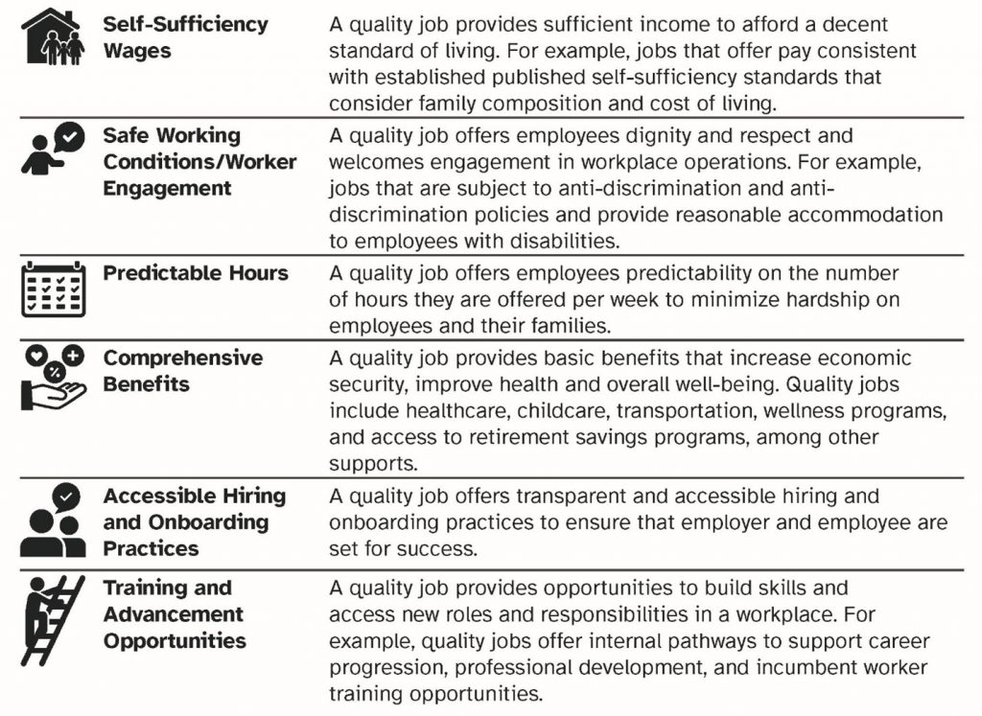
High Road Employer Criteria

Slide 25
Follow-Up Services
Retention with the Same Employer: Percentage of participants with wage records who exit from WIOA core programs and were employed by the same employer in the second and fourth quarters after exit.
Business Solutions
WIOA Participant
High Road Employer

Slide 26
Customer Flow – WIOA Title I-B (Adult, DW, Youth)
Title III
Career Services
Select a Training from State list
Support Complete Training
Job Placement with Any Employer
Follow-Up Participant Only
80%
20%
Optional
All Core/Required Partners
Regional Approved Training
Support to Complete Training
Job Placement with High Road Employer
Follow-Up with Employer & Participant
90%
Required

Slide 27
Thank you!

